Slide 1
CH 4
Structured Query
Language (SQL)
& Indexing

Slide 2
SQL
SQL stands for Structured Query Language. It is used for storing and managing data in relational database management system.
It is a standard language for Relational Database System. It enables a user to create, read, update and delete relational databases and tables.
SQL allows users to query the database in a number of ways, using English-like statements.

Slide 3
SQL follows the following rules:
Structure query language is not case sensitive. Generally, keywords of SQL are written in uppercase.
Statements of SQL are dependent on text lines. We can use a single SQL statement on one or multiple text line.
Using the SQL statements, you can perform most of the actions in a database.
SQL depends on tuple relational calculus and relational algebra

Slide 4
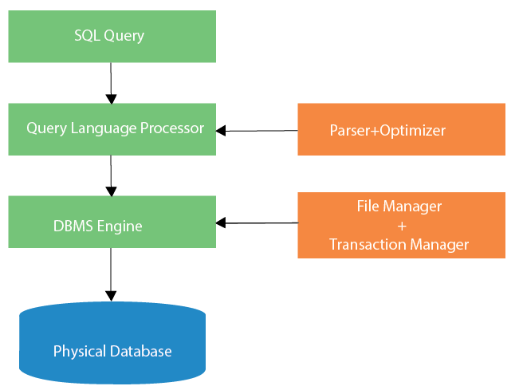

Slide 5
Characteristics of SQL
SQL is easy to learn.
SQL is used to access data from relational database management systems.
SQL can execute queries against the database.
SQL is used to describe the data.
SQL is used to define the data in the database and manipulate it when needed.
SQL is used to create and drop the database and table.
SQL is used to create a view, stored procedure, function in a database.
SQL allows users to set permissions on tables, procedures, and views.

Slide 6
Advantages of SQL
There are the following advantages of SQL:
High speed
Using the SQL queries, the user can quickly and efficiently retrieve a large amount of records from a database.
No coding needed
In the standard SQL, it is very easy to manage the database system. It doesn't require a substantial amount of code to manage the database system.

Slide 7
Portability
SQL can be used in laptop, PCs, server and even some mobile phones.
Interactive language
SQL is a domain language used to communicate with the database.
Well defined standards
Long established are used by the SQL databases that are being used by ISO and ANSI.

Slide 8
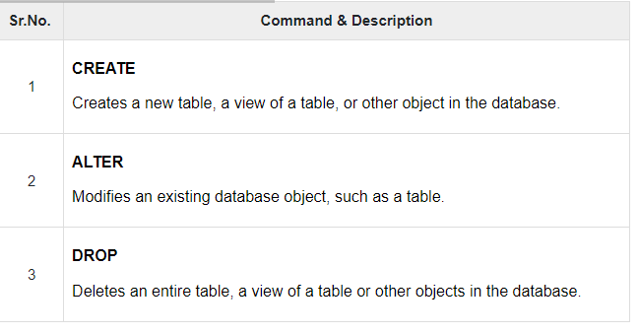
DDL - Data Definition Language

Slide 9
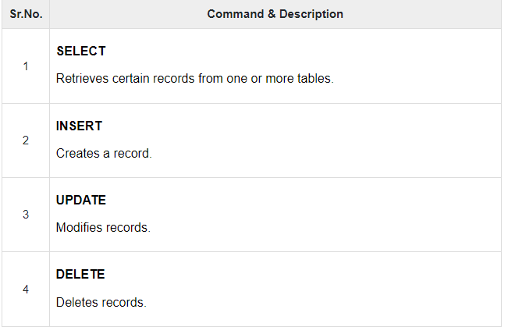
DML - Data Manipulation Language

Slide 10
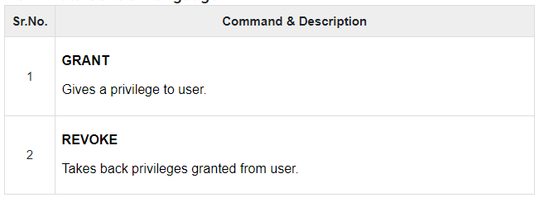
DCL - Data Control Language

Slide 11
Set operations
The SQL Set operation is used to combine the two or more SQL SELECT statements.
Types of Set Operation
Union
UnionAll
Intersect
Minus

Slide 12
1. Union
The SQL Union operation is used to combine the result of two or more SQL SELECT queries.
In the union operation, all the number of datatype and columns must be same in both the tables on which UNION operation is being applied.
The union operation eliminates the duplicate rows from its resultset.

Slide 13
Syntax
SELECT column_name FROM table1
UNION
SELECT column_name FROM table2;

Slide 14
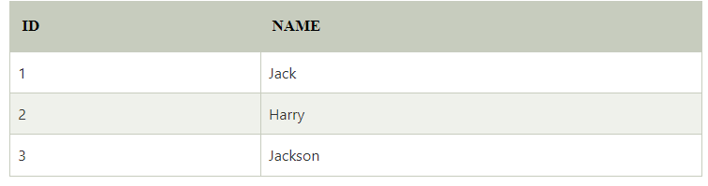
The First Table

Slide 15
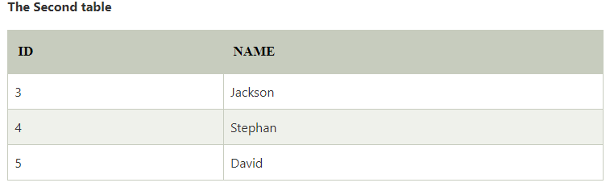

Slide 16
Union SQL query will be:
SELECT * FROM First
UNION
SELECT * FROM Second;

Slide 17
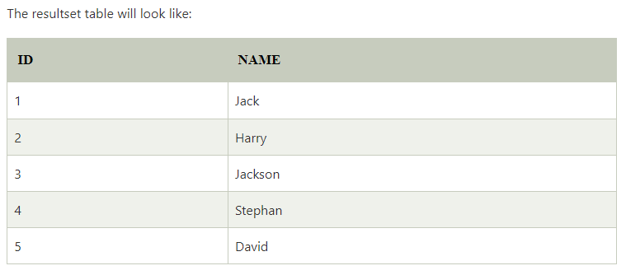

Slide 18
2. Union All
Union All operation is equal to the Union operation. It returns the set without removing duplication and sorting the data.
Syntax:
SELECT column_name FROM table1
UNION ALL
SELECT column_name FROM table2;

Slide 19
Example: Using the above First and Second table.
Union All query will be like:
SELECT * FROM First
UNION ALL
SELECT * FROM Second;

Slide 20
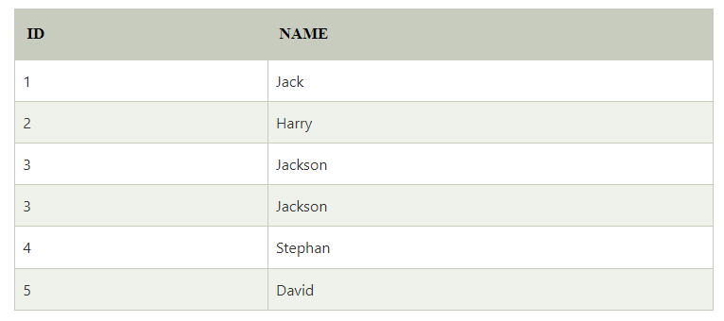

Slide 21
3. Intersect
It is used to combine two SELECT statements. The Intersect operation returns the common rows from both the SELECT statements.
In the Intersect operation, the number of datatype and columns must be the same.
It has no duplicates and it arranges the data in ascending order by default.

Slide 22
Syntax
SELECT column_name FROM table1
INTERSECT
SELECT column_name FROM table2;
Example:
Using the above First and Second table.
Intersect query will be:
SELECT * FROM First
INTERSECT
SELECT * FROM Second;

Slide 23
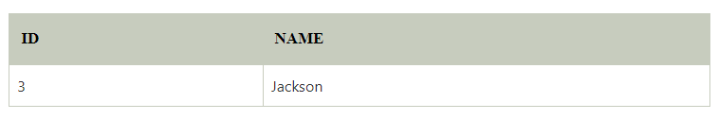

Slide 24
4. Minus
It combines the result of two SELECT statements. Minus operator is used to display the rows which are present in the first query but absent in the second query.
It has no duplicates and data arranged in ascending order by default.
Syntax:
SELECT column_name FROM table1
MINUS
SELECT column_name FROM table2;

Slide 25
Minus query will be:
SELECT * FROM First
MINUS
SELECT * FROM Second;

Slide 26
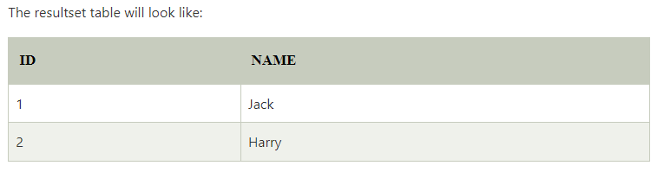

Slide 27
SQL Aggregate Functions
What is an Aggregate Function in SQL?
An aggregate function in SQL returns one value after calculating multiple values of a column. We often use aggregate functions with the GROUP BY and HAVING clauses of the SELECT statement.
COUNT() Function
SUM() Function
AVG() Function
MIN() Function

Slide 28
COUNT() Function
The COUNT() function returns the number of rows in a database table.
Syntax:
COUNT(*)
or
COUNT( [ALL|DISTINCT] expression )

Slide 29
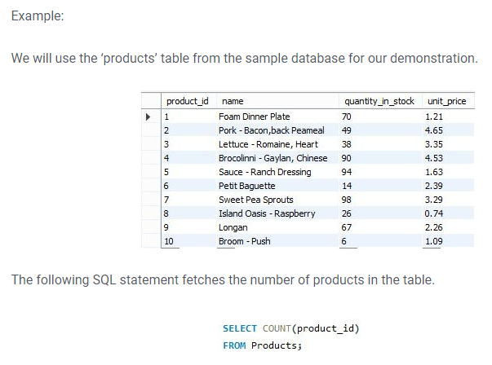

Slide 30
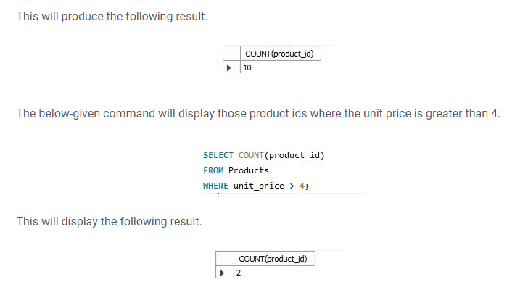

Slide 31
SUM() Function
The SUM() function returns the total sum of a numeric column.
Syntax:
SUM()
or
SUM( [ALL|DISTINCT] expression )

Slide 32
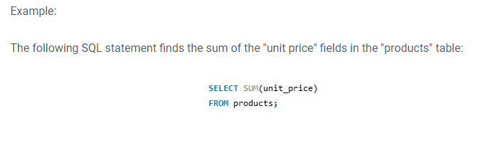

Slide 33
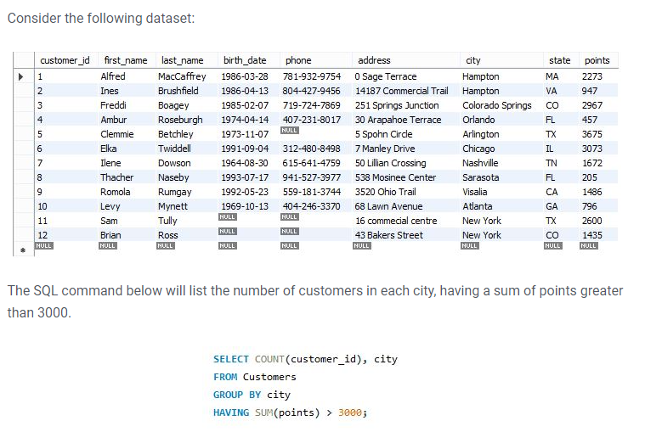

Slide 34
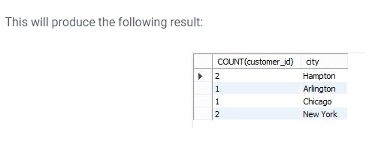

Slide 35
AVG() Function
The AVG() function calculates the average of a set of values.
Syntax:
AVG()
or
AVG( [ALL|DISTINCT] expression )

Slide 36
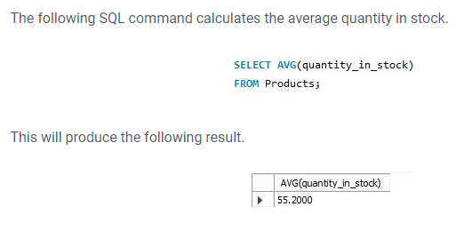

Slide 37
MIN() Function
The MIN() aggregate function returns the lowest value (minimum) in a set of non-NULL values.
Syntax:
MIN()
or
MIN( [ALL|DISTINCT] expression )

Slide 38
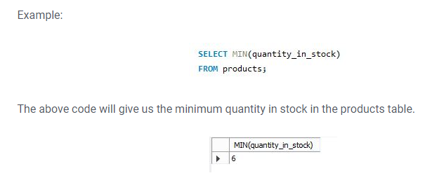

Slide 39
MAX() Function
The MAX() aggregate function returns the highest value (maximum) in a set of non-NULL values.
Syntax:
AVG()
or
AVG( [ALL|DISTINCT] expression )

Slide 40
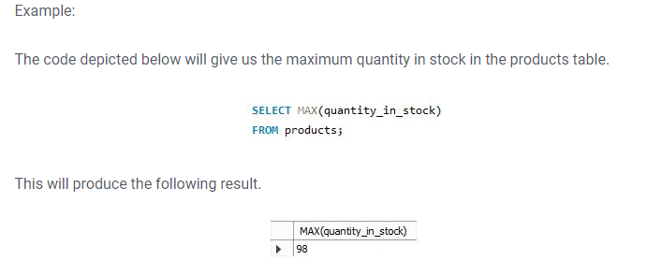

Slide 41
Complex Retrieval Queries using Group By
The GROUP BY clause is a SQL command that is used to group rows that have the same values.
The GROUP BY clause is used in the SELECT statement.
The queries that contain the GROUP BY clause are called grouped queries and only return a single row for every grouped item.

Slide 42
SQL GROUP BY Syntax
SELECT statements... GROUP BY column_name1[,column_name2,...] [HAVING condition];
HERE,
“SELECT statements…” is the standard SQL SELECT command query.
“GROUP BY column_name1” is the clause that performs the grouping based on column_name1.
“[,column_name2,…]” is optional; represents other column names when the grouping is done on more than one column.
“[HAVING condition]” is optional; it is used to restrict the rows affected by the GROUP BY clause. It is similar to the WHERE clause.

Slide 43
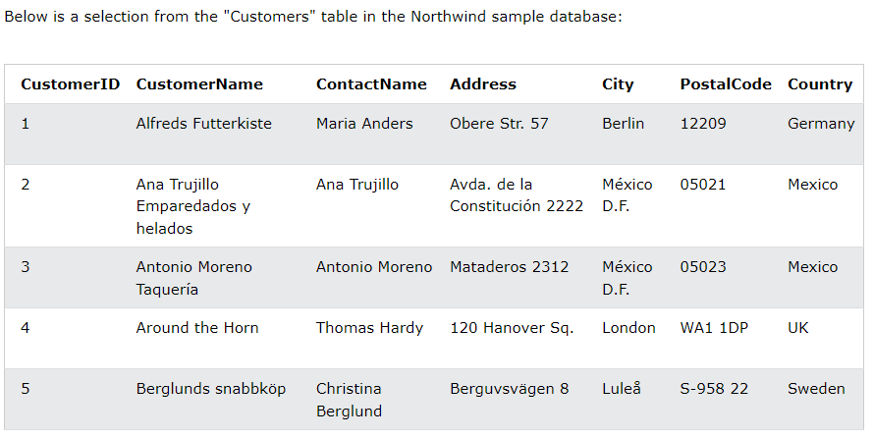

Slide 44
SELECT COUNT(CustomerID), Country
FROM Customers
GROUP BY Country;

Slide 45
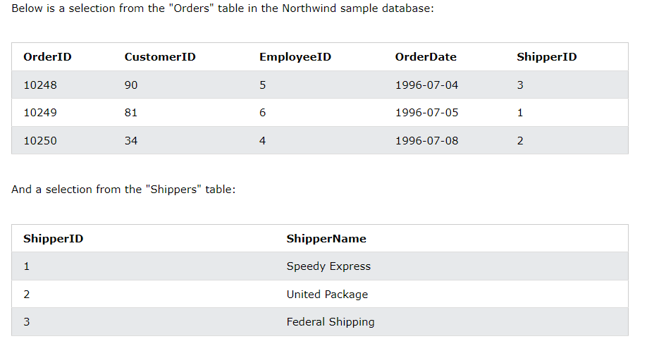

Slide 46
SELECT Shippers.ShipperName, COUNT(Orders.OrderID) AS NumberOfOrders FROM Orders
LEFT JOIN Shippers ON Orders.ShipperID = Shippers.ShipperID
GROUP BY ShipperName;

Slide 47
In SQL, the GROUP BY clause is used to group rows by one or more columns.
For example,
SELECT country, COUNT(*) AS number
FROM Customers
GROUP BY count
SQL command groups the rows by the country column, and counts the number of each country (because of the COUNT() function).

Slide 48
SELECT customer_id, SUM(amount) AS total
FROM Orders
GROUP BY customer_id;

Slide 49
GROUP BY can also be used to group rows based on multiple columns.
For example,
SELECT country, state, MIN(age) as min_age
FROM Persons
GROUP BY country, state;

Slide 50
We can use the GROUP BY clause with the HAVING clause to filter the result set based on aggregate functions.
For example,
SELECT COUNT(customer_id), country
FROM Customers
GROUP BY country
HAVING COUNT(customer_id) > 1

Slide 51
NATURAL JOIN
Join more than one relation that has got common attribute.
Symbol:
∏ rollno, name, feess (student specialization )

Slide 52
As the name shows, JOIN means to combine something. In case of SQL, JOIN means "to combine two or more tables".
In SQL, JOIN clause is used to combine the records from two or more tables in a database.
Types of SQL JOIN
INNER JOIN
LEFT JOIN
RIGHT JOIN
FULL JOIN

Slide 53
Types of SQL JOIN
INNER JOIN
LEFT JOIN
RIGHT JOIN
FULL JOIN

Slide 54
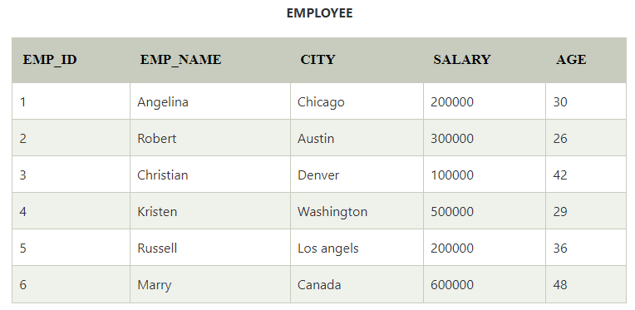
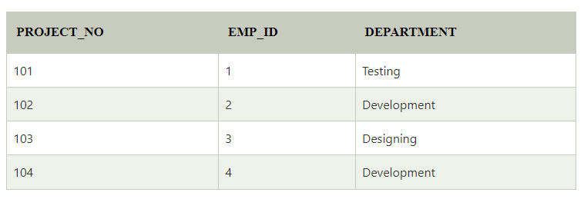

Slide 55
1. INNER JOIN
In SQL, INNER JOIN selects records that have matching values in both tables as long as the condition is satisfied. It returns the combination of all rows from both the tables where the condition satisfies.
Syntax
SELECT table1.column1, table1.column2, table2.column1,....
FROM table1
INNER JOIN table2
ON table1.matching_column = table2.matching_column;

Slide 56
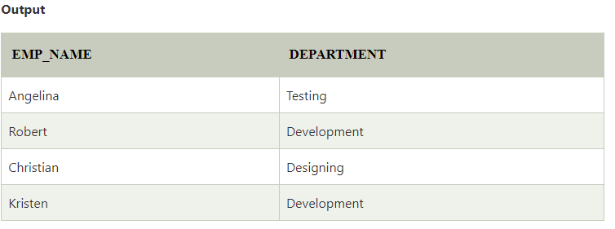
Query
SELECT EMPLOYEE.EMP_NAME, PROJECT.DEPARTMENT
FROM EMPLOYEE
INNER JOIN PROJECT
ON PROJECT.EMP_ID = EMPLOYEE.EMP_ID;

Slide 57
2. LEFT JOIN
The SQL left join returns all the values from left table and the matching values from the right table. If there is no matching join value, it will return NULL.
Syntax
SELECT table1.column1, table1.column2, table2.column1,....
FROM table1
LEFT JOIN table2
ON table1.matching_column = table2.matching_column;

Slide 58
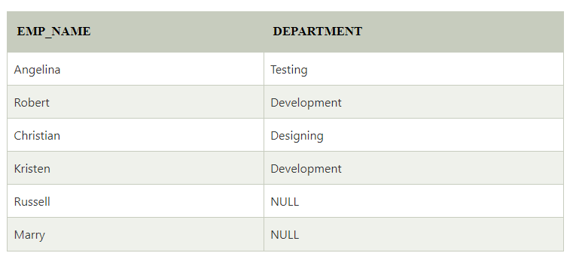
SELECT EMPLOYEE.EMP_NAME, PROJECT.DEPARTMENT
FROM EMPLOYEE
LEFT JOIN PROJECT
ON PROJECT.EMP_ID = EMPLOYEE.EMP_ID;

Slide 59
3. RIGHT JOIN
In SQL, RIGHT JOIN returns all the values from the values from the rows of right table and the matched values from the left table. If there is no matching in both tables, it will return NULL.
Syntax
SELECT table1.column1, table1.column2, table2.column1,....
FROM table1
RIGHT JOIN table2
ON table1.matching_column = table2.matching_column;

Slide 60
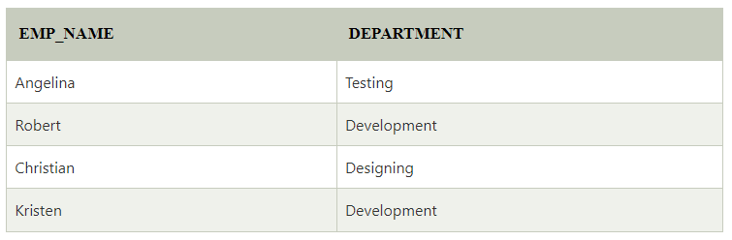
SELECT EMPLOYEE.EMP_NAME, PROJECT.DEPARTMENT
FROM EMPLOYEE
RIGHT JOIN PROJECT
ON PROJECT.EMP_ID = EMPLOYEE.EMP_ID;

Slide 61
4. FULL JOIN
In SQL, FULL JOIN is the result of a combination of both left and right outer join. Join tables have all the records from both tables. It puts NULL on the place of matches not found.
Syntax
SELECT table1.column1, table1.column2, table2.column1,....
FROM table1
FULL JOIN table2
ON table1.matching_column = table2.matching_column;

Slide 62
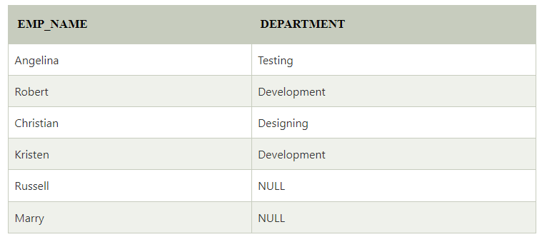
Query
SELECT EMPLOYEE.EMP_NAME, PROJECT.DEPARTMENT
FROM EMPLOYEE
FULL JOIN PROJECT
ON PROJECT.EMP_ID = EMPLOYEE.EMP_ID;

Slide 63
Integrity constraints in SQL
Integrity constraints are a set of rules. It is used to maintain the quality of information.
Integrity constraints ensure that the data insertion, updating, and other processes have to be performed in such a way that data integrity is not affected.
Thus, integrity constraint is used to guard against accidental damage to the database.

Slide 64
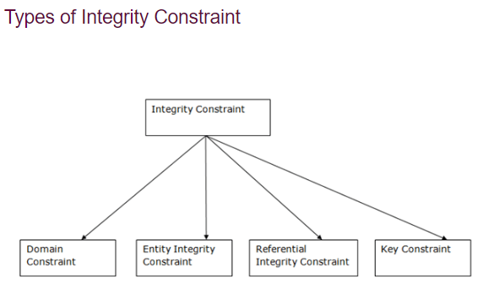

Slide 65
Domain constraints
Domain constraints can be defined as the definition of a valid set of values for an attribute.
The data type of domain includes string, character, integer, time, date, currency, etc.
The value of the attribute must be available in the corresponding domain.

Slide 66
2. Entity integrity constraints
The entity integrity constraint states that primary key value can't be null.
This is because the primary key value is used to identify individual rows in relation and if the primary key has a null value, then we can't identify those rows.
A table can contain a null value other than the primary key field.

Slide 67
3. Referential Integrity Constraints
A referential integrity constraint is specified between two tables.
4. Key constraints
Keys are the entity set that is used to identify an entity within its entity set uniquely.
An entity set can have multiple keys, but out of which one key will be the primary key. A primary key can contain a unique and null value in the relational table.

Slide 68
Security and authorization: Grant & Revoke in SQL Functions
Grant Privileges
You can grant users various privileges to tables. These permissions can be any combination of SELECT, INSERT, UPDATE, DELETE, REFERENCES, ALTER, or ALL.
Syntax
GRANT privileges ON object TO user;

Slide 69
Example
If you wanted to grant SELECT, INSERT, UPDATE, and DELETE privileges on a table called employees to a user name smith, you would run the following GRANT statement:
GRANT SELECT, INSERT, UPDATE, DELETE ON employees TO smith;

Slide 70
Revoke Privileges
Once you have granted privileges, you may need to revoke some or all of these privileges. To do this, you can run a revoke command.
You can revoke any combination of SELECT, INSERT, UPDATE, DELETE, REFERENCES, ALTER, or ALL.
Syntax
REVOKE privileges ON object FROM user;

Slide 71
Example
If you wanted to revoke DELETE privileges on a table called employees from a user named anderson, you would run the following REVOKE statement:
REVOKE DELETE ON employees FROM anderson;

Slide 72
Procedures in SQL and cursors.
A function or procedure is a set of instructions to perform some task.
A cursor is an array that can stores the result set of a query.
The general syntax for writing a procedure is as follows:
CREATE PROCEDURE procedure_name
AS
sql_statement
GO;

Slide 73
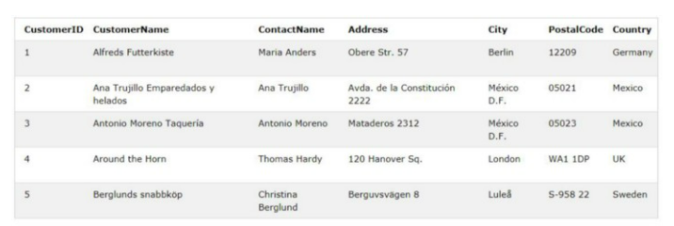
Write a procedure named SelectAllCustomers which will select all the customers from Customers-
CREATE PROCEDURE SelectAllCustomers
AS
SELECT * FROM Customers
GO;

